Slide 1
Data Structures
Final Project
PhoneBook
Abdul Ahad Imtiaz-22751
Muhammad Ahsan Ali Khan-22839
Sameer Alam-22739

Slide 2
Introduction
Our project is maintaining a phone directory in memory which works during run time and perform nearly all the operations that can be done on a digital phonebook. We first made a text file with random names and random numbers with realistic parameters (using our own code). Then we used a specific piece of code in our project only aimed at filling up phone directory with dummy values using the said text file. This is as far as the job for text file goes. We have created a GUI using swing on Netbeans.

Slide 3
Importance of the Project
Over the years a person interacts with numerous people and therefore its contacts increase with time. If the person tries to maintain a file or a book to write all of its contacts, it will be very cumbersome to search or maintain that list. The solution to this problem is to use a digital phone book that does all this work in nearly constant time. It is very efficient in its functionalities such as, searching a contact, updating a contact, adding a new contact, deleting a contact and lastly, it also sorts the contacts in alphabetical order for the user.

Slide 4
Data Structures used:
Hash Tables
Binary Search Tree
Array

Slide 5
Hash Table
The main reason for choosing this data structure over others was speed. The access time of data on average is O(1). As most of our functions were accessing data like, deleting, updating and, searching contacts, we chose hash table as the most suitable data structure to do the job.
We made an object of contact with three parameters namely name, primary number , and secondary number. This contact was stored in Hash Table. Hashing is performed on names using the power rule and technique for rehashing is quadratic probing.

Slide 6
Binary Search Tree
The main purpose of using this data structure in our project was to sort the contacts. We used Binary Search Tree because nearly all the other sorting techniques used O(n²) time for sorting whereas, once we implement BST and do inorder traversal the sorting time is reduced to O(n) only. Secondly, BST was easy to implement for us.
We have created two functions: insert and LNR (InOrder Traversal). A contact is stored in node broken down into its three components. Comparisons during insertion are performed on basis of names.

Slide 7
Array
We used Array mainly as a supporting data structure. The main instances where we made use of this data structure was while splitting our String and inserting it into the JTable for displaying contacts in GUI and inserting it into the Binary Search Tree from the Hashtable while performing the sort operation on the data.

Slide 8
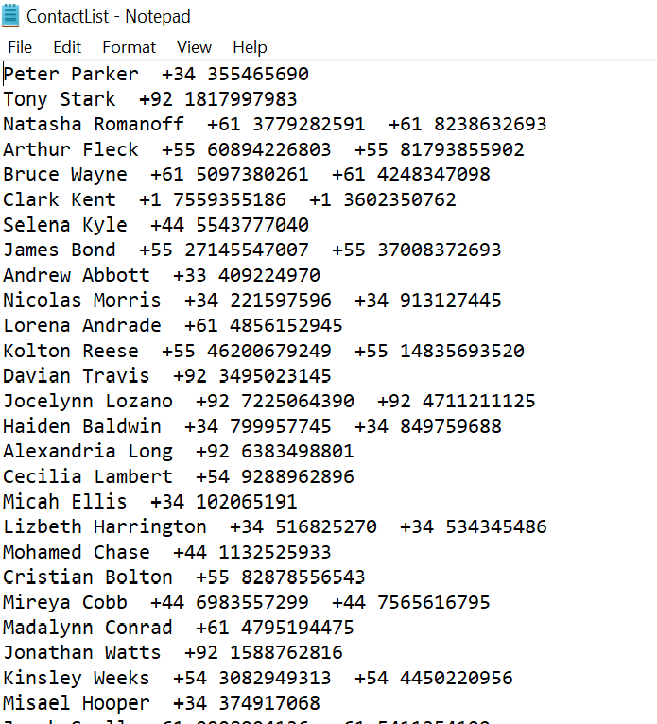
Sample Data

Slide 9
Big-Oh Analysis
Insert, Search and Delete Contact: These methods basically call their respective methods in Hashtable. The big-Oh of these methods depend on the load factor or the length of the cluster that may have formed in the hashtable in worst case. As we have chosen a good hash function the big-oh is the average case i.e. O(1).
Edit Contact: This method first calls the delete method and then the insert method, therefore its average case is also O(1).

Slide 10
Big-Oh Analysis
Show Contact: This operation calls custom method, list(). Which displays the data from the hashtable to the JTable in GUI. Since the whole hashtable is traversed for displaying all the contacts the big-oh is O(n).
Sort Contact: This method first inserts the contacts from hashtable to a BST and then calls InOrder Traversal method, LNR(Node root). The big-Oh for insertion is O(nlogn) and for traversal (sorting) it is O(n).

Slide 11
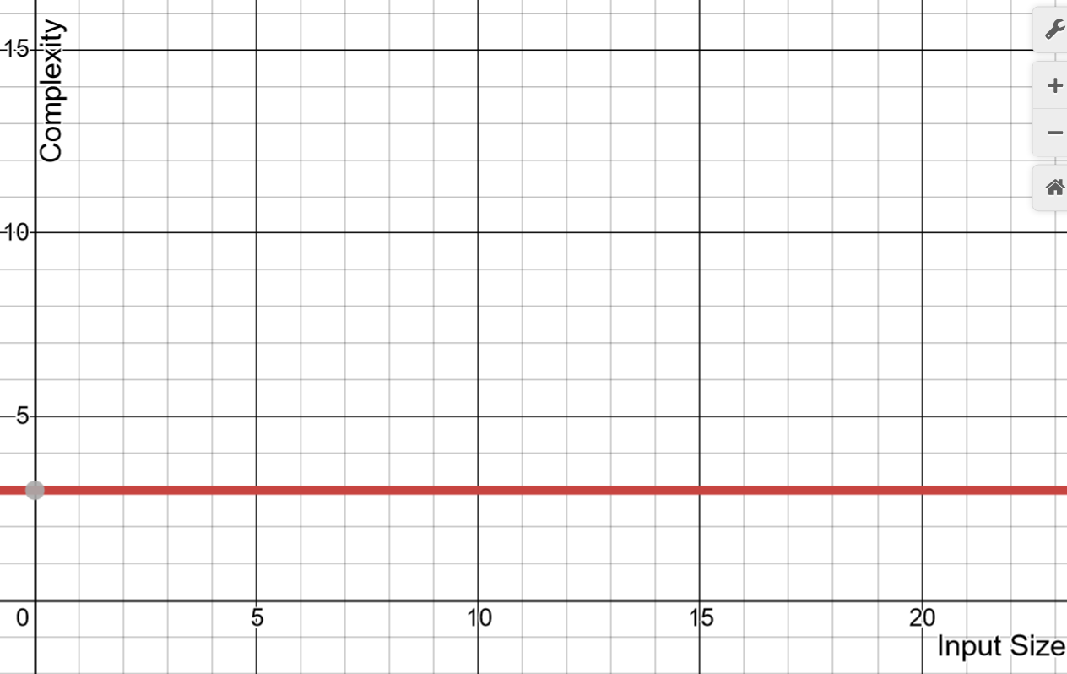
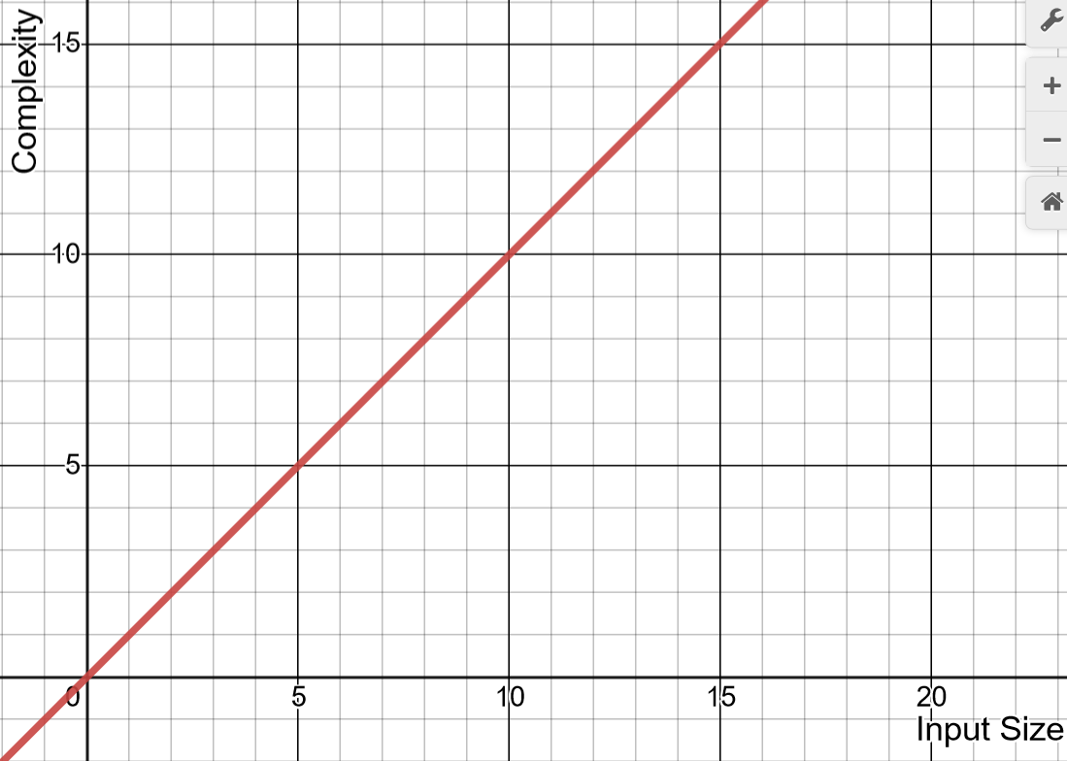
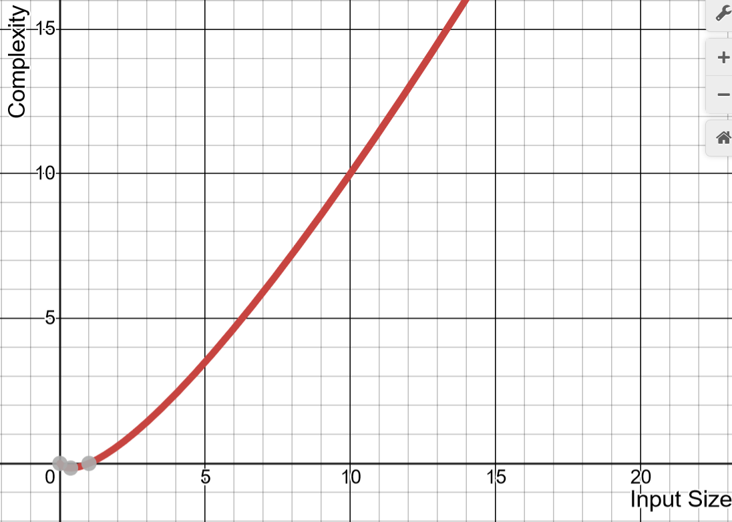
Big-Oh Analysis
O(1)
O(n)
O(nlogn)

Slide 12
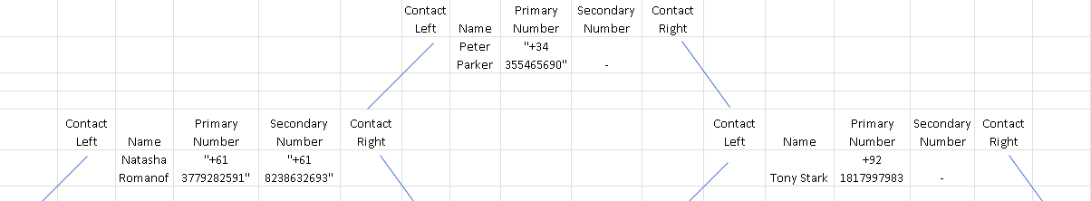

Slide 13
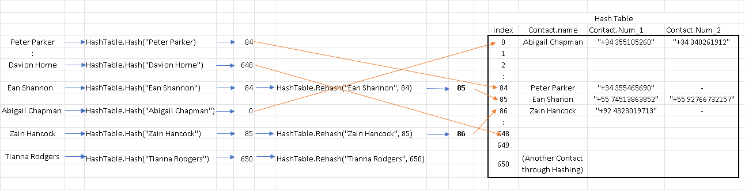

Slide 14
Reference
https://www.javatpoint.com/java-joptionpane
https://www.randomlists.com/random-names?qty=400

